Slide 1

WEB 2.0

Slide 2


In the realm of Web 2.0, Quotus is more than just an observer; we are your proactive partner. Our team's expertise extends into the dynamic world of Web 2.0, where collaboration and user-generated content drive digital success. At Quotus, we empower your digital presence to become an interactive and thriving ecosystem. We understand the significance of interactivity, social networking, and user-generated content, which all contribute to your organization's success in this ever-evolving digital landscape. By merging cutting-edge technology with the boundless opportunities of Web 2.0, we pave the way for enhanced efficiency, valuable insights, and data-driven excellence.

Slide 3


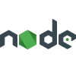






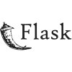



TECHNOLOGIES WE’RE WORKING ON
BACKEND FRAMEWORKS
FRONTEND FRAMEWORKS
DATABASES

Slide 4
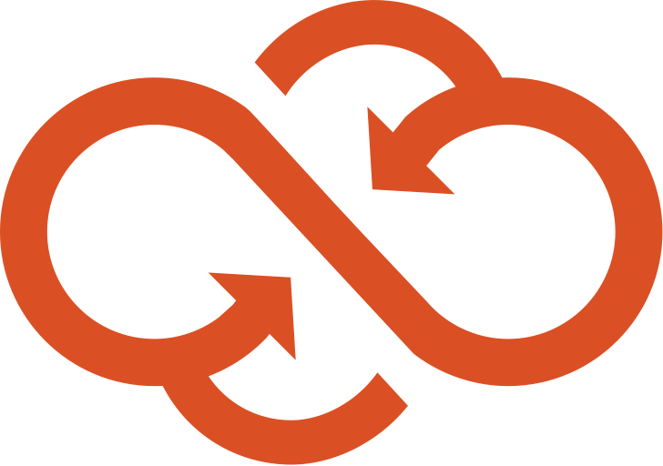
PROJECTS
SAGA TECH:
Saga Tech, an online gaming platform, presented unique challenges, including the need for a complex admin site with multiple layouts and an intuitive tab navigation system.
We leveraged our expertise in Next.js to implement server-side rendering, ensuring fast loading times and an engaging user experience.
Our solution included server-side pagination, enhancing data exploration, and Redux for efficient client-side state management.
The result was a user-friendly, high-performance admin site, driving improved user engagement and streamlined gaming platform management. Saga Tech experienced increased user satisfaction and retention, ultimately boosting their revenue.
TECH STACK: Next JS, Tailwind CSS, React redux & Redux toolkit
CLIENT: Saga-Tech

Slide 5
PROJECTS
CLOUD10 LMS(LOYALTY MANAGEMENT SYSTEM):
Cloud10 LMS (Loyalty Management System) is a platform that helps businesses to integrate, implement and manage their loyalty programs. It provides a centralized platform for tracking customer interactions, managing rewards and incentives, and analyzing customer behavior and preferences. The system is designed as a pluggable module for Channels or Booking Engines of the hospitality domain.
FEATURES:
Customer Backend: A decentralized customer backend on the Cardano blockchain can provide a secure and transparent way to store customer information, including their purchase history, loyalty program status.
Transaction records can be stored on the blockchain to maintain an immutable history of each customer's purchases, enabling retailers to provide personalized offers and recommendations based on their purchase history.
The use of smart contracts on the Cardano blockchain can enable retailers to implement loyalty programs that can automatically reward customers based on their purchases and other predetermined criteria. With Cardano's high level of security, customers can be assured that their personal data is protected and cannot be tampered with or hacked.

Slide 6
Overall, a decentralized customer backend on the Cardano blockchain can offer numerous benefits for retailers and customers, including increased transparency, security, and personalized experiences.
Rewards management: A module for managing rewards and incentives, such as points, discounts, free products, or exclusive offers. Customer Engagement: Tools for engaging customers, such as targeted messaging, personalized recommendations, and social media integrations.
Analytics and reporting: A dashboard that provides insights into customer behavior, program performance, and ROI. Administration and security: Tools for managing program rules, settings, and access levels, as well as ensuring compliance with data protection regulations
BACKEND STACK: NODE JS, EXPRESS JS, NATS-STREAMING-SERVER, TYPESCRIPT, KUBERNETES, DOCKER
FRONTEND STACK: NEXT JS, TAILWIND CSS, TYPESCRIPT
CLIENT: Cloud10 Hospitality

Slide 7
PROJECTS
PDF SCRAPER:
Our PDF scraping project for MJunction is a testament to our cross-technology expertise, utilizing Node.js, Python, and Flask to solve intricate data extraction challenges.
The project begins by creating a PDF format from the source document, ensuring data consistency and structure.
To extract text, each PDF page is converted into an image, enabling further processing and analysis. The Optical Character Recognition (OCR) package is employed to accurately decipher the text from these images.
We've developed a custom script, employing regular expressions (regex), to extract text in key-value pairs. This process ensures that critical data is organized and easily accessible.
For tabular data within the PDFs, we employ computer vision techniques using the OpenCV (cv2) library. We initially identify the vertical and horizontal lines defining table boundaries, enabling precise data extraction.
Within tables, our solution identifies each cell, ensuring accurate extraction of text in tabular format. This approach allows for structured presentation of tabular data.
This robust PDF scraping solution was tailored to meet MJunction's specific needs, enabling efficient and accurate data extraction from a variety of documents.
TECH STACK: Express.js, Node.js, Python & PostgreSQL
CLIENT: Mjunction

Slide 8
PROJECTS
NATUROPURA:
Naturopura stands at the forefront of agricultural transformation in India, combining cutting-edge technology with a visionary approach. This project harnesses the power of advanced tools and frameworks to redefine the way agriculture operates in the country.
Powered by technologies such as Node.js, Express.js, and Next.js, Naturopura ensures a responsive, efficient, and seamless user experience. These JavaScript-based technologies enable rapid development, real-time interactions, and scalability, which are crucial for a dynamic agricultural marketplace.
Our choice of databases, including MongoDB and MySQL, reinforces the platform's robustness. These databases facilitate data management, storage, and retrieval, ensuring that information critical to the agricultural supply chain is readily available. This process ensures that critical data is organized and easily accessible.
To further solidify the project's technical foundation, we've embraced Haskell, a functional programming language known for its reliability and mathematical precision. Haskell brings a layer of dependability to Naturopura, enhancing security, performance, and maintainability.
With this powerful technology stack, Naturopura transforms the agricultural landscape, connecting farmers and consumers seamlessly. It's a dynamic, efficient, and transparent platform poised to catalyze growth and sustainability in India's agricultural sector, supporting fair trade and empowering the agricultural community.
TECH STACK: Express.js, Node.js, Mysql, MongoDB, Next.js
CLIENT: Quotus3

Slide 9
THANK YOU

